Slide 1

Introduction
This project is for who is planning to visit places in Canada.
This project suggests the best locations to visit in Canada.
This report explores which neighborhoods of Canada have the most visit Venues.
Also, this project answers the questions “Where should I open a Venue?” and “Where should I stay If I want to visit a popular venue?”

Slide 2
Data
Postal Code of Canada are obtained from https://en.wikipedia.org/wiki/List_of_postal_codes_of_Canada:_M
Latitude and Longitude values are obtained by using "geocoder".
All data related to locations are obtained by using Foursquare API and Python Libraries.

Slide 3
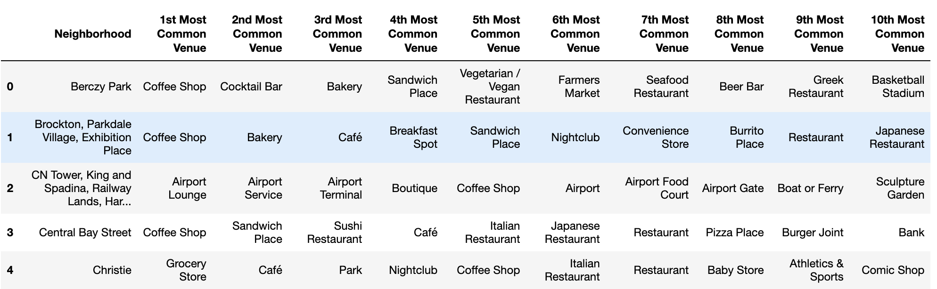
Methodology
Master data which includes “PostalCode”, “Borough” and “Neighborhood” information of Canada.
Python Folium library was used to visualize map of Canada, Toronto and its districts. In order to get Latitude and Longitudes of Toronto, geopy and geocoder are used. The map below was obtained.
In order to explore and categorize places Foursquare API was used. Here is a head of the list Venues name and category, information from Foursquare API. 1494 venues are returned.

Slide 4
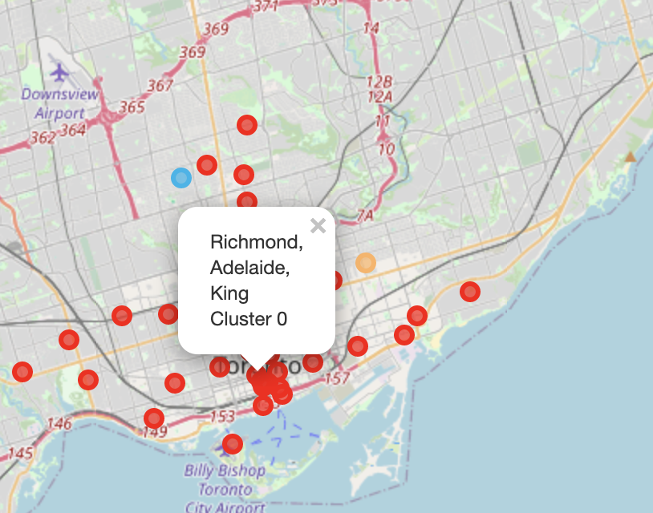
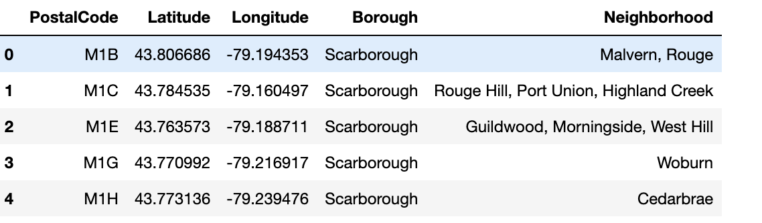
Methodology

Slide 5
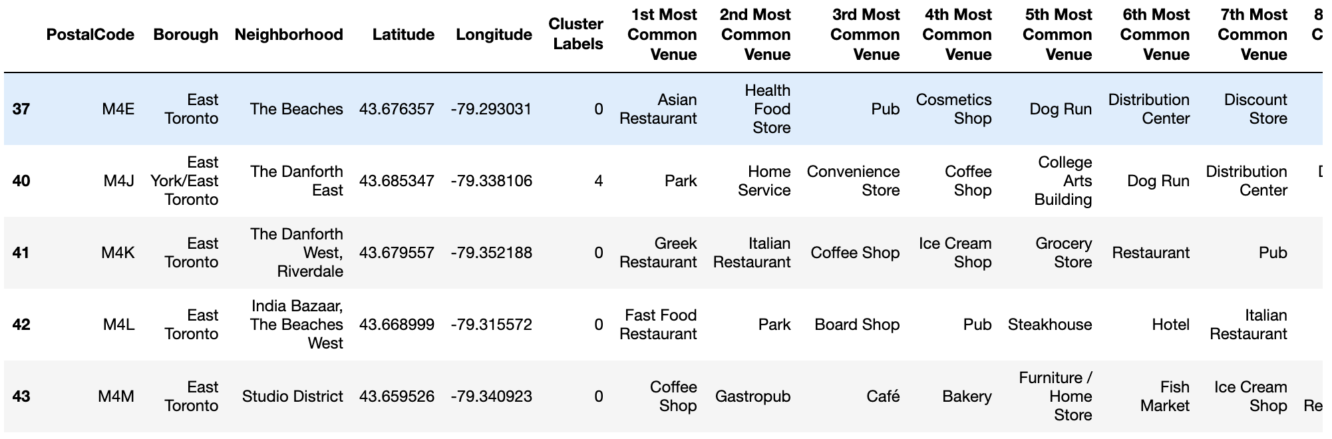
Methodology
There are common venues in districts, so unsupervised K-means algorithm was used to cluster districts. K-Means cluster was set to 5 clusters, to reach optimum accuracy.

Slide 6
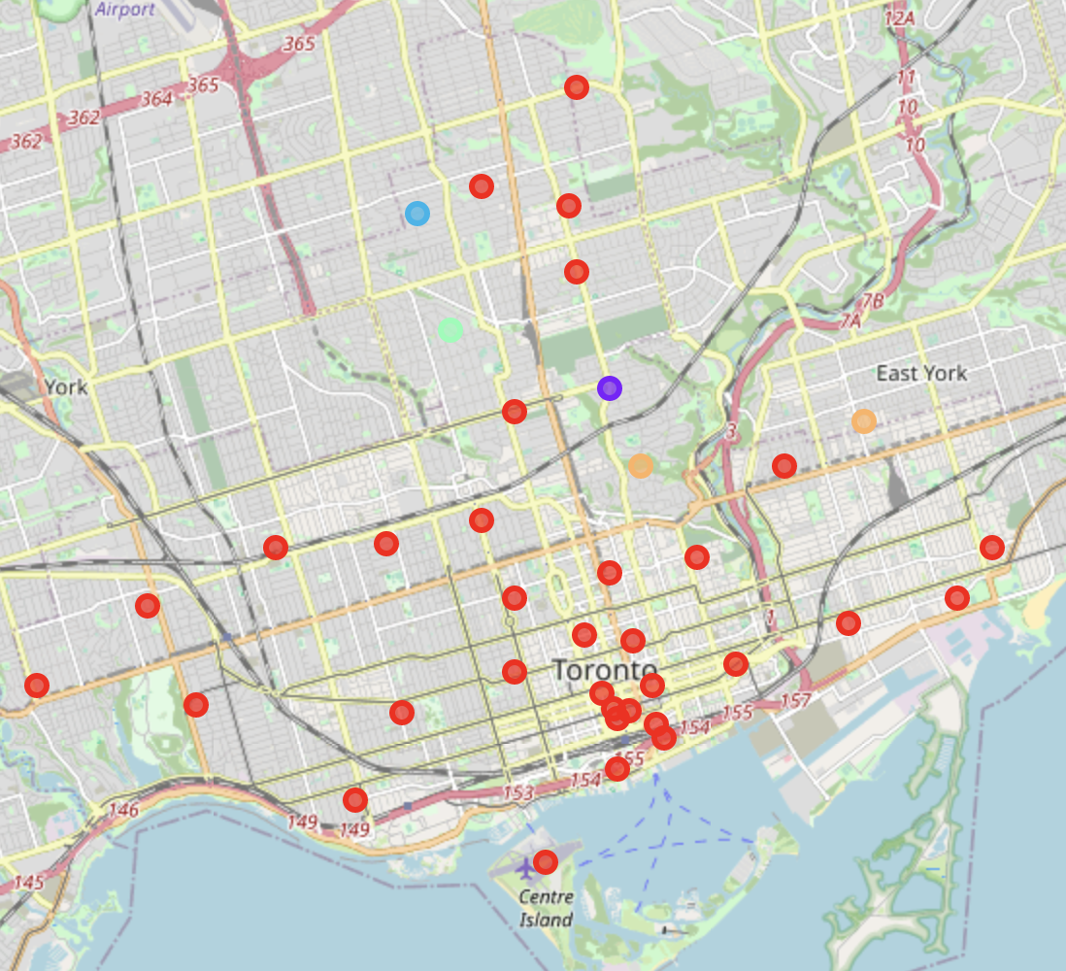
Results
Cluster 0 includes most of the area. Coffee shops are most common venues in Cluster 0.

Slide 7
Discussion and Conclusion
K-means algorithm was used as part of this clustering study. K value was set to 5. For more detailed and accurate guidance, the data set can be expanded, and the details of the neighborhood or street can also be drilled.
It is obvious that Cluster 0 is the most usable clusters to see which venue to visit.

